Slide 1

Spotify Predictive Analytics Modeling
Laura Hoffmann

Slide 2

Data Exploration
Cleaning
Analysis
Visualization
Correlation Evaluation

Slide 3

Cleaning
Duplicate Values
Missing Values
Variable Evaluation (Dropping)

Slide 4

Analysis
Genre Breakdown
Underground Rap (largest)
Pop (smallest)
Differences
Feature Explanation
Danceability
Energy
Key
Loudness
Mode
Speechiness
Acousticness
Instrumentalness
Liveness
Valence
Tempo
Duration
Time Signature

Slide 5

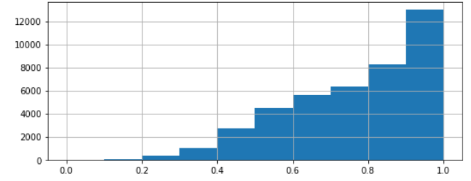
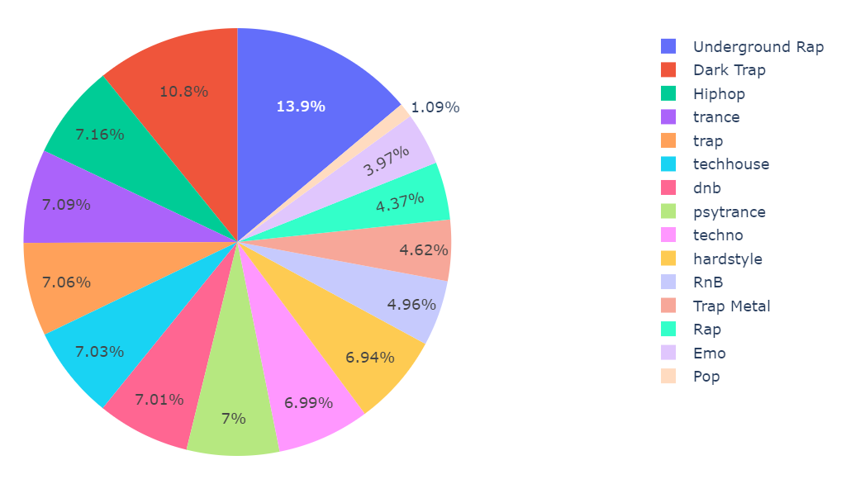
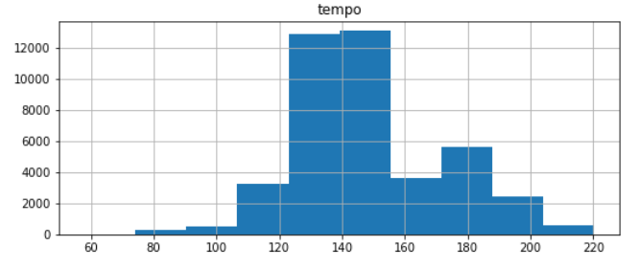
Visualization
Energy Distribution
Genre Distribution
Tempo Distribution

Slide 6
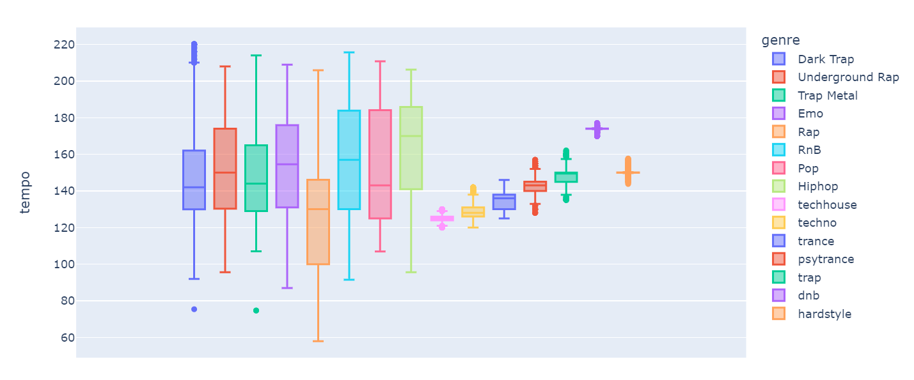
Tempo Distributions by Genre

Slide 7
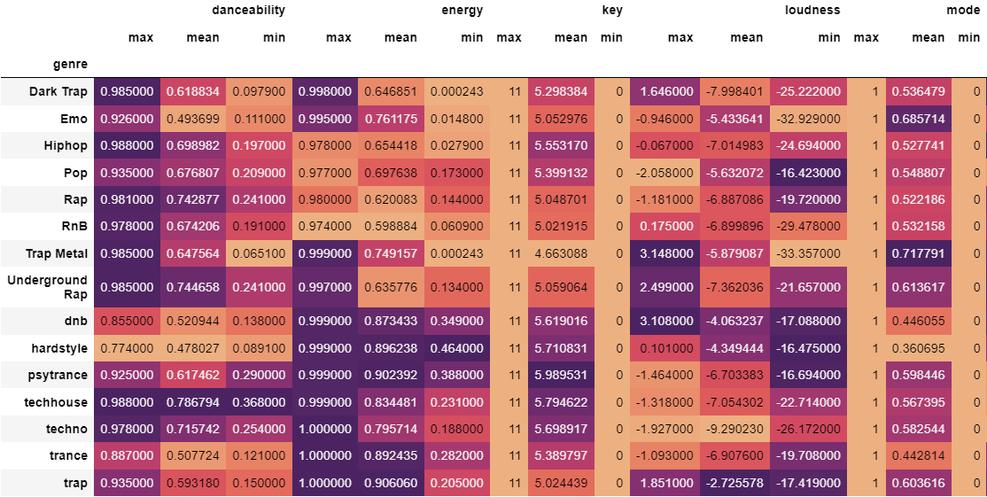
Statistics

Slide 8
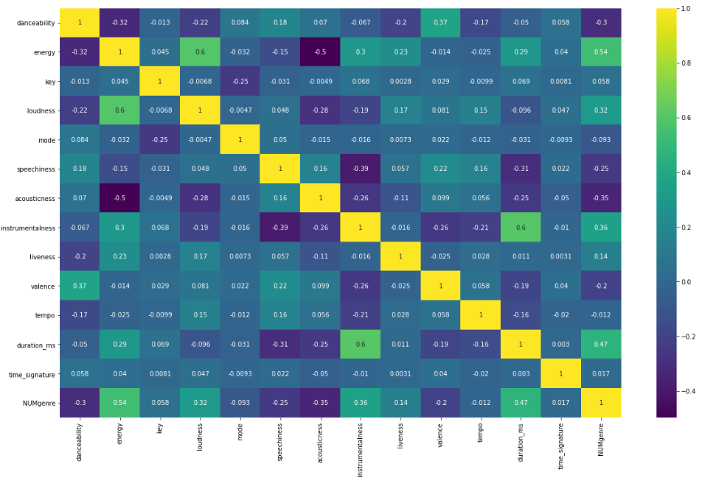
Correlation Evaluation
High Correlations
Energy & Loudness
Duration & Instrumentalness
Energy & Genre
Low Correlations
Acousticness & Energy
Instrumentalness & Speechiness

Slide 9
Modeling
Standardize Features
SkLearn StandardScaler()
Classify Songs into Liked or Not
Artificial Neural Network
Classification with Supervised Learning
Finding Common Features to Separate Samples into Classes

Slide 10
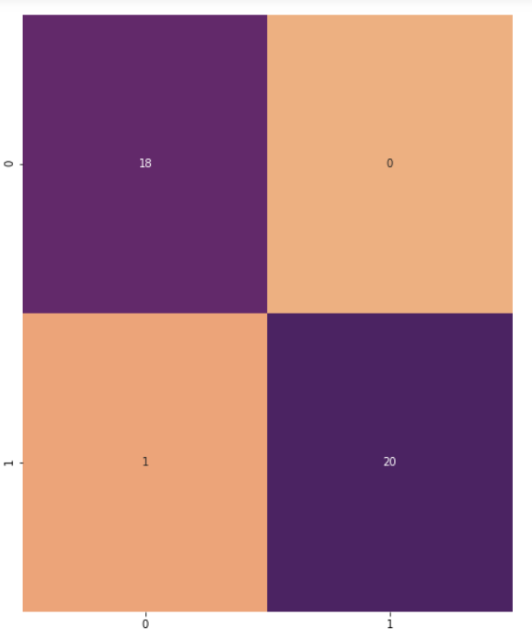
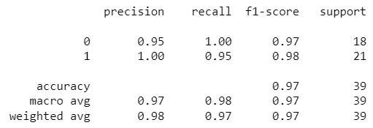
Modeling
Test Confusion Matrix
Separate Dependent Variable: “Liked”
Split/Train Data
80% Train -- 20% Test
Keras Sequential Model
Test Classification Report

Slide 11



Conclusion
Analysis
Modeling
Suggestion

